Slide 1

Welcome to Section 6!
Documents, KNN, Kernel Methods
May 9th, 2024

Slide 2
Announcements
HW 5 to be released Friday
Learning reflection 6 is out and due 05/13 - Monday

Slide 3
Agenda
Concept Review/Questions
Precision/Recall
Embeddings and distance metrics
Local Methods
Practice problems throughout the slides
Kaggle Demo (extra slides)

Slide 4
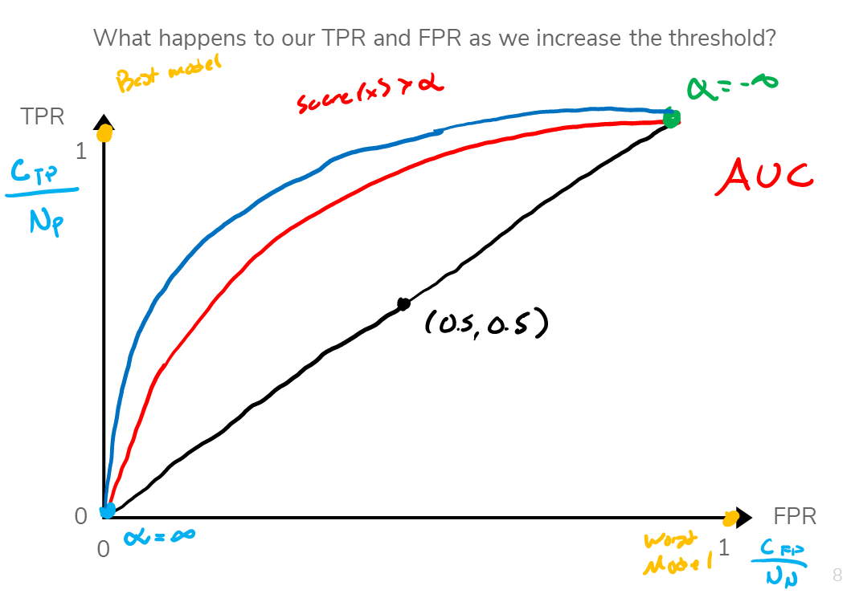
Receiver Operating Characteristic Curves
ROC Curve
Quick & easy way to visualize changing metrics as threshold (alpha) increases
Best model comes close to upper left corner
Worst model approaches bottom right corner
Analyze the AUC (area under curve)
Tells us the degree/measure of separability
Notes:
Y-axis has the TPR
X-axis has the FPR
ROC is a probability curve and AUC represents the degree or measure of separability. It tells how much the model is capable of distinguishing between classes.
Q: From this diagram, which curve represents the better model?

Slide 5


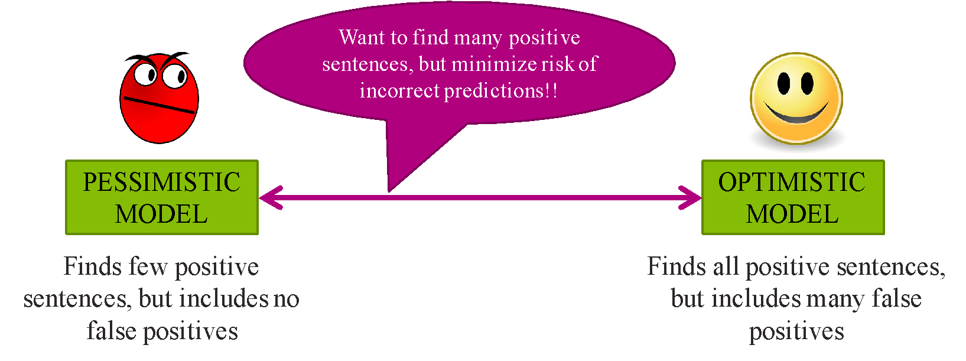
Precision and Recall
More complex metrics
Use True Positive rate in combination with others
Precision:
of classified as positive, how many were truly positive?
Recall:
of all that was positive, how many did I predict as positive?
Optimistic vs Pessimistic model
Predicted Label
 | True Positive (TP) | False Negative (FN)
 | False Positive (FP) | True Negative (TN)
True Label

Slide 6
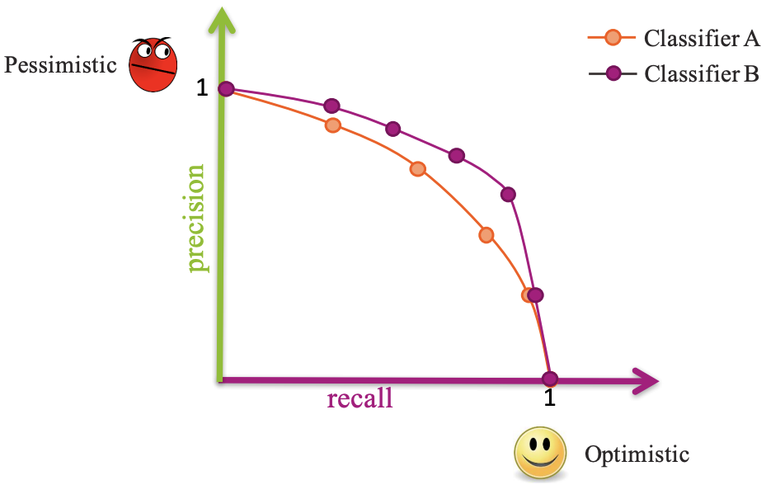
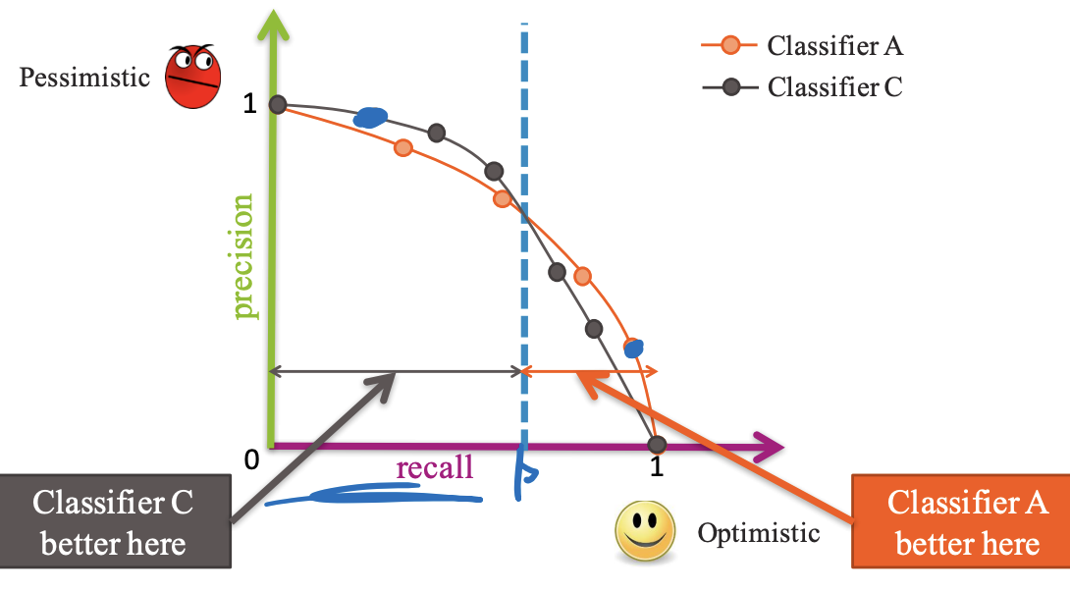
Precision and Recall
Notes:
Why is the purple model better than the orange model?
For the same recall, the precision is higher. What does this mean?
There will be less false positives

Slide 7
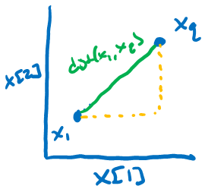

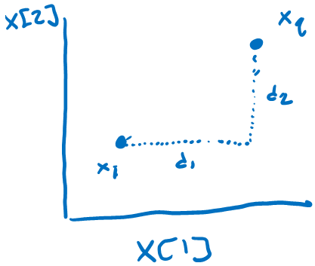

Distances (Euclidean vs Manhattan)
Euclidean Distance
Simple to define
Manhattan Distance
Orthogonal paths
Notes:
Euclidean distance: shortest distance between 2 points

Slide 8
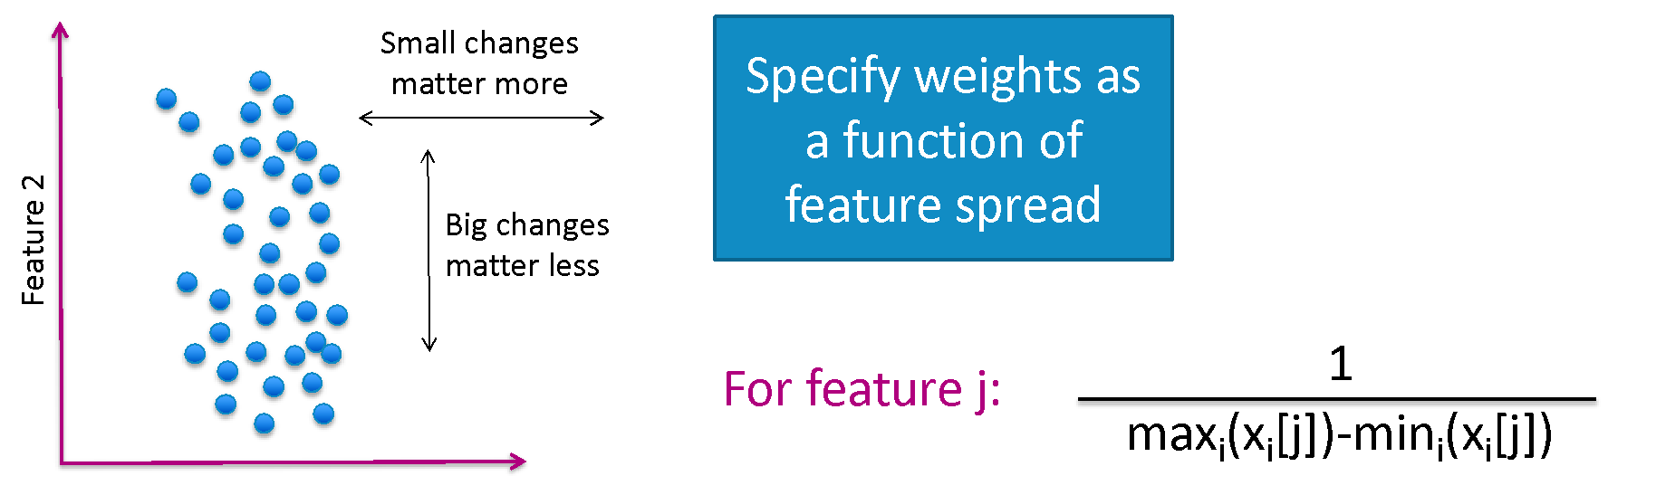

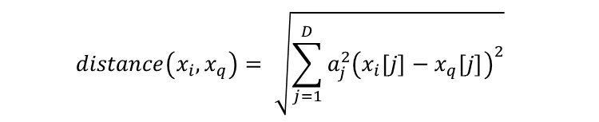
Weighted Distance
Some features vary more than others or are measured in different ways
Weighting dimensions makes distance metric more reasonable
Weighted Euclidean Distance
Notes:
Weighting the dimensions means we can take into account the spread/variability of the feature
Because distance can be affected by the spread of the data, by weighting the dimensions, the distance metric is more robust against different variations in the data

Slide 9
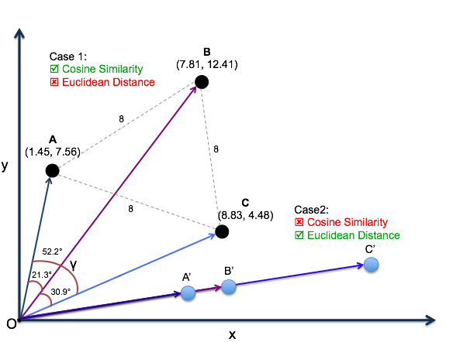
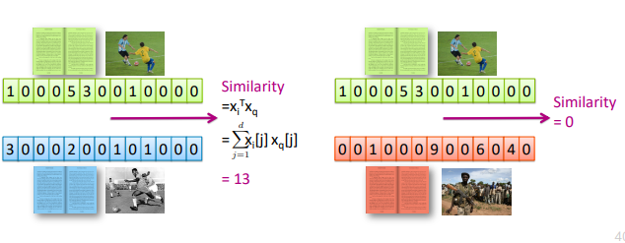
Similarity
Unlike distance, a greater similarity is better for recommendation
More similar = greater #
Notes:
Similarity represents how alike are these 2 vectors/objects

Slide 10
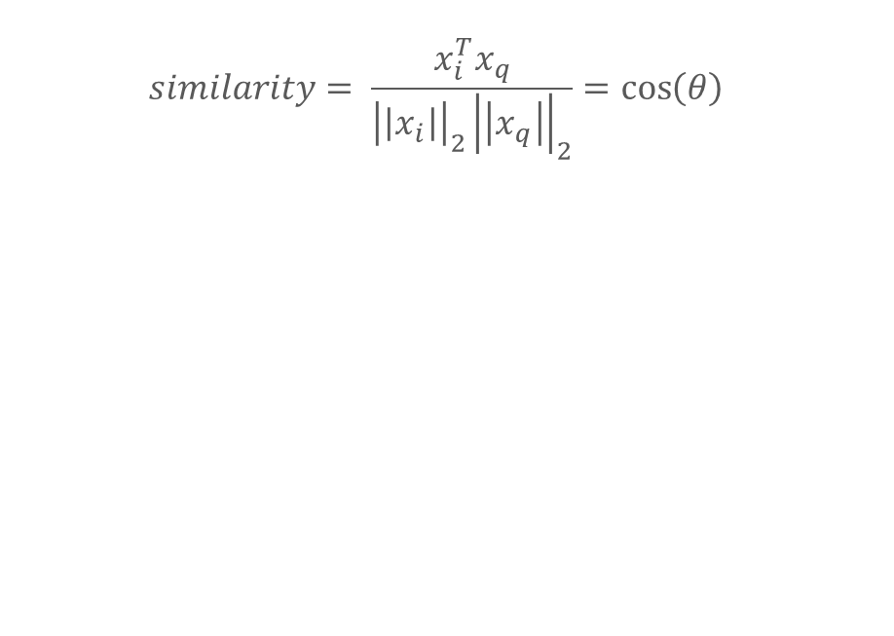
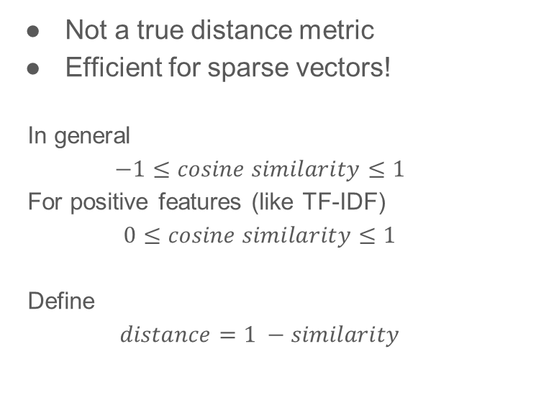
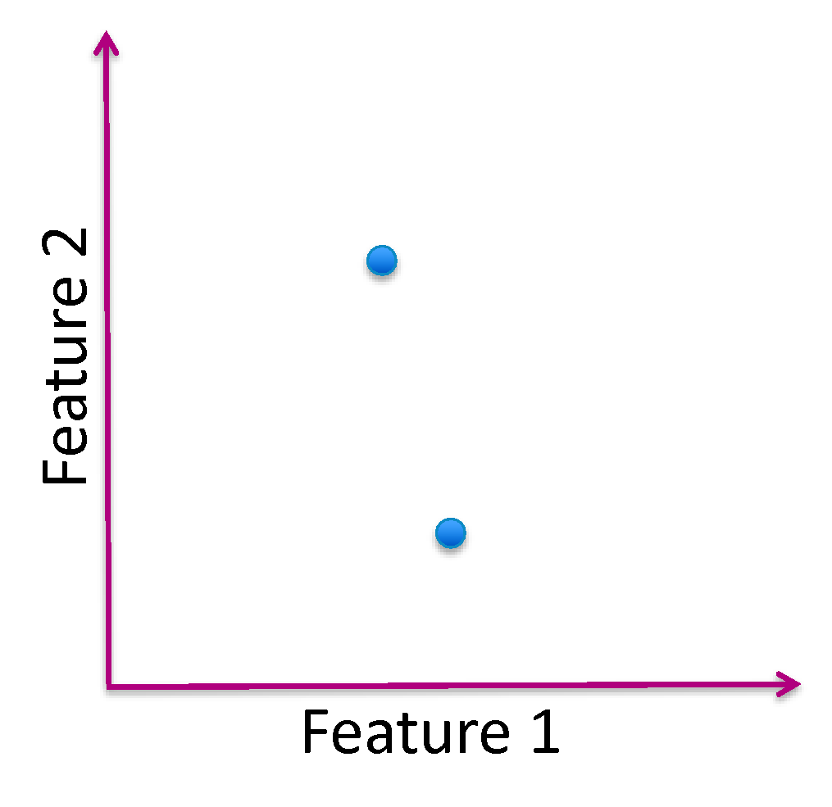
Cosine Similarity
Notes:
The cosine similarity is beneficial because even if the two similar data objects are far apart by the Euclidean distance because of the size, they could still have a smaller angle between them. Smaller the angle, higher the similarity.
What does it mean when the cosine similarity is 1? -> Angle is very small
Similar
What does it mean when the cosine similarity is 0? -> Angle is 90 degrees
No similarity
What does it mean when the cosine similarity is -1?
Negative relationship
When plotted on a multi-dimensional space, the cosine similarity captures the orientation (the angle) of the data objects and not the magnitude. Because of that, where the how close the data objects are in the space can help us capture the similarity between 2 objects more. Magnitude might not be a robust enough metric.

Slide 11
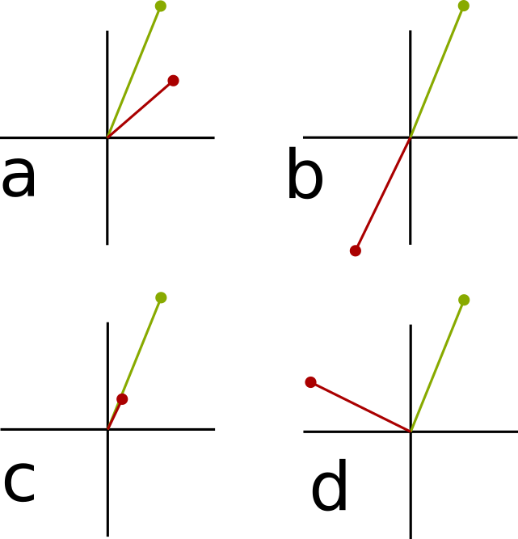
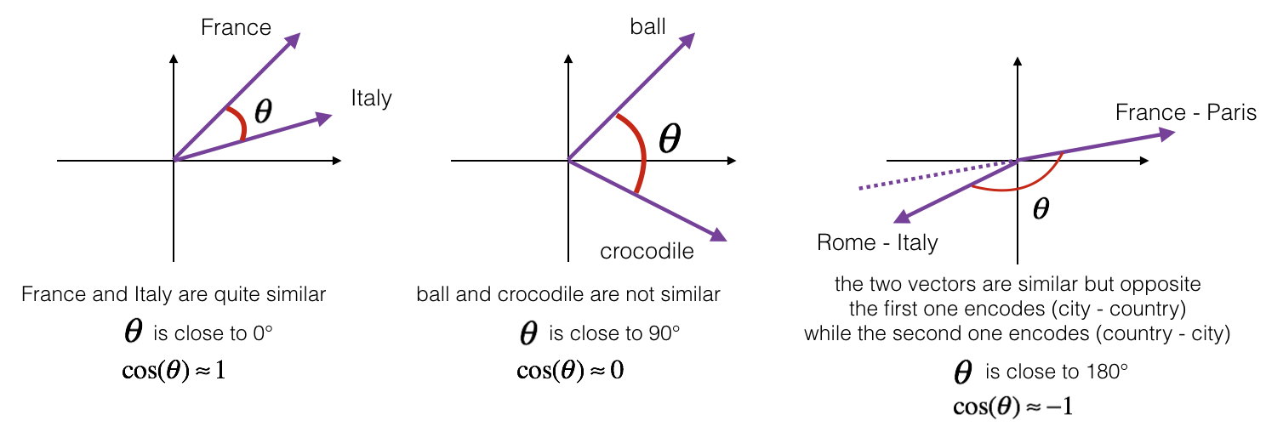
Similarity Questions
Order pairs of vectors in decreasing similarity
Which pairs have positive similarity scores? Which pairs have negative similarity scores?
Notes:
C, a, d, b
C most similar, B least similar
C, A positive
D is nearly 0 (ambiguous on purpose)
B is negative

Slide 12
Embeddings
words used in text data to a vector since we cannot use text data to train a model

Slide 13
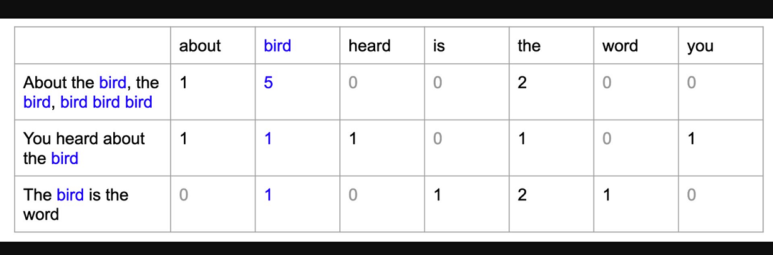
Bag of Words
Treat words equally, output most common words as most important
Advantages:
Easy to describe
Fast to compute
Weaknesses:
Common words dominate counts
Uncommon words tend to define a document

Slide 14
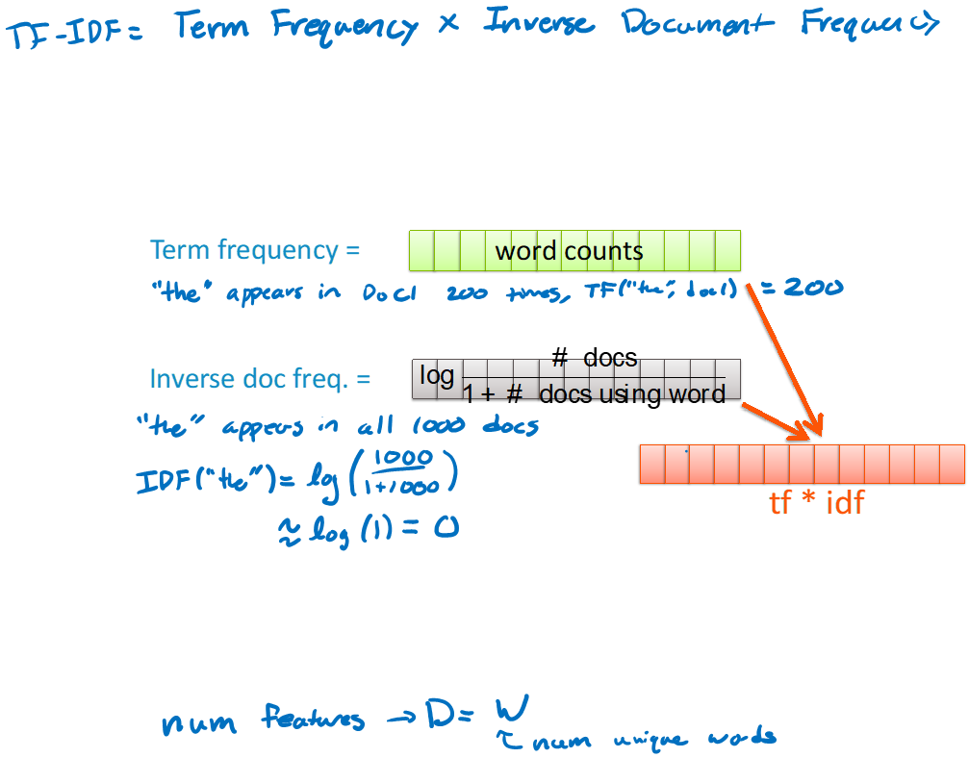
Term Frequency Inverse-Document Frequency
Emphasizes important words
Term Frequency: how common are words in a single document
Inverse Document Frequency: how common are words across the collection (corpus) of documents
Pairwise multiplication to find TF-IDF of each word
Notes:
Penalizes common words

Slide 15
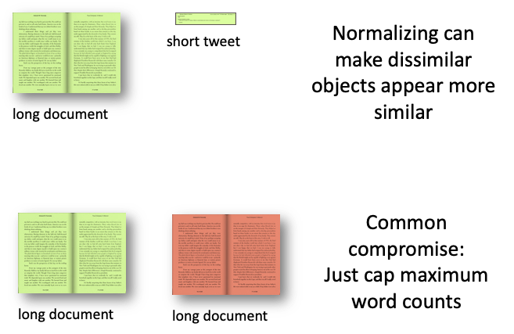
Normalizing
Normalization is not desired when comparing documents of different sizes since it ignores length
In practice, can use multiple distance metrics and combine them using some defined weights
Alternately, don’t normalize, but cap max number of words

Slide 16
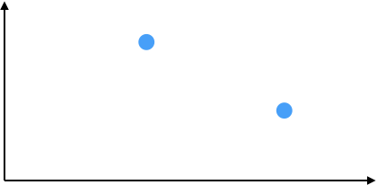
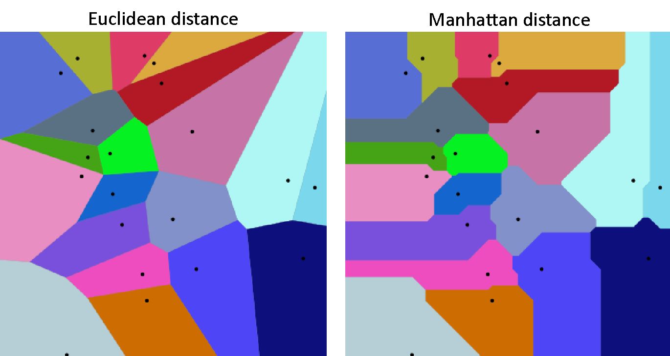


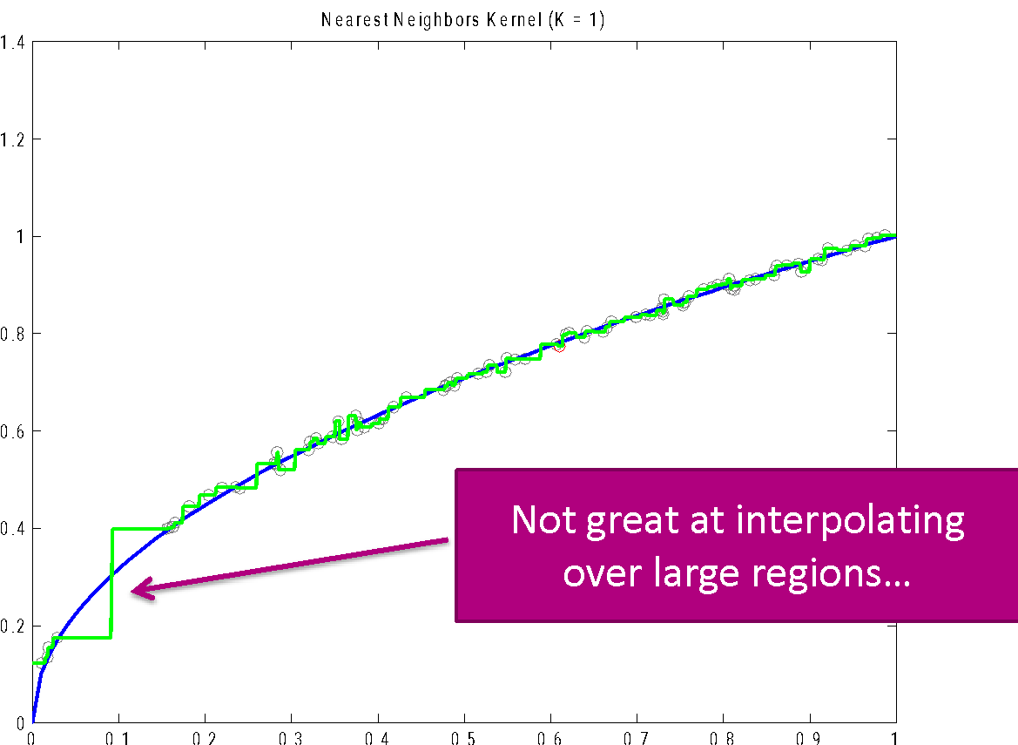

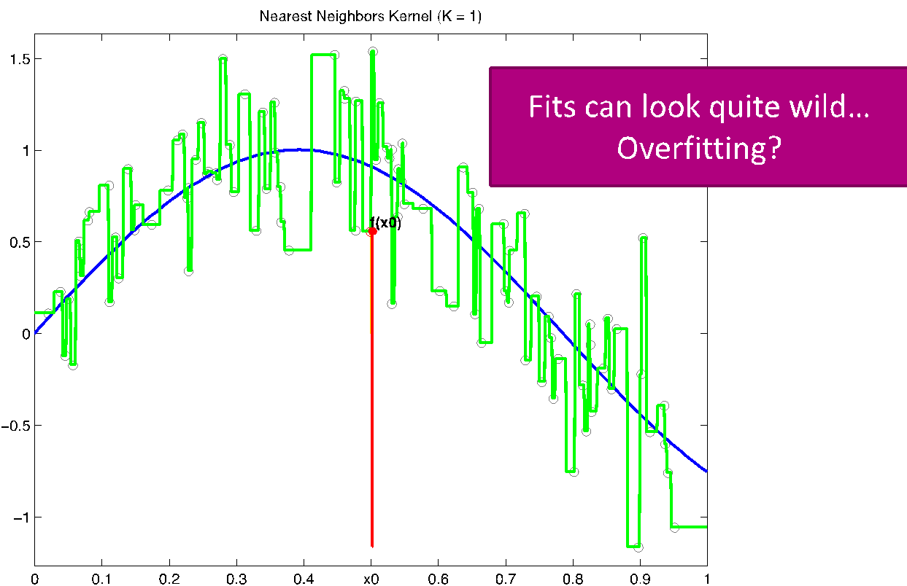
Nearest Neighbor
Visualizing with Voronoi Tessellation
Definitions of “closest”
Euclidean distance
Manhattan distance
Weaknesses:
Weaker with sparse data
Potential to overfit
O(n) complexity with n data points

Slide 17
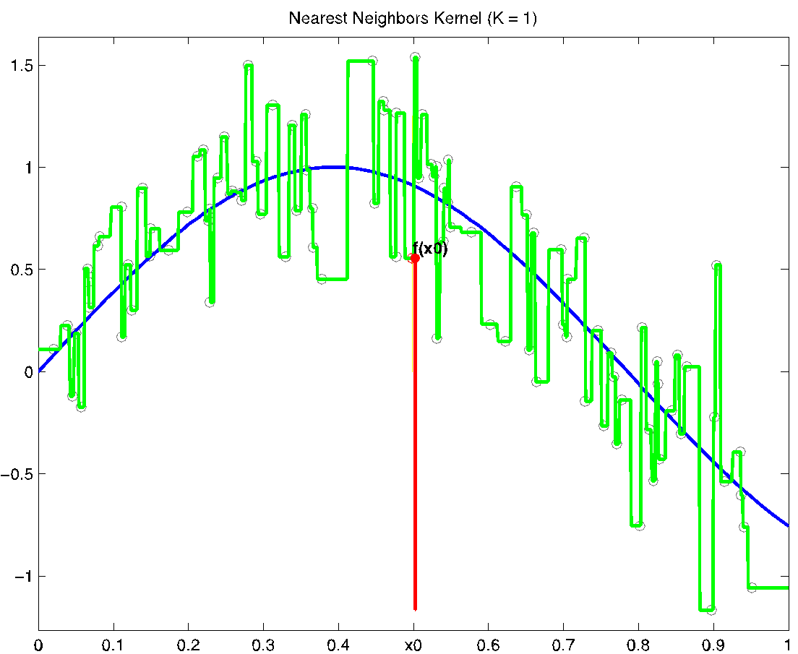
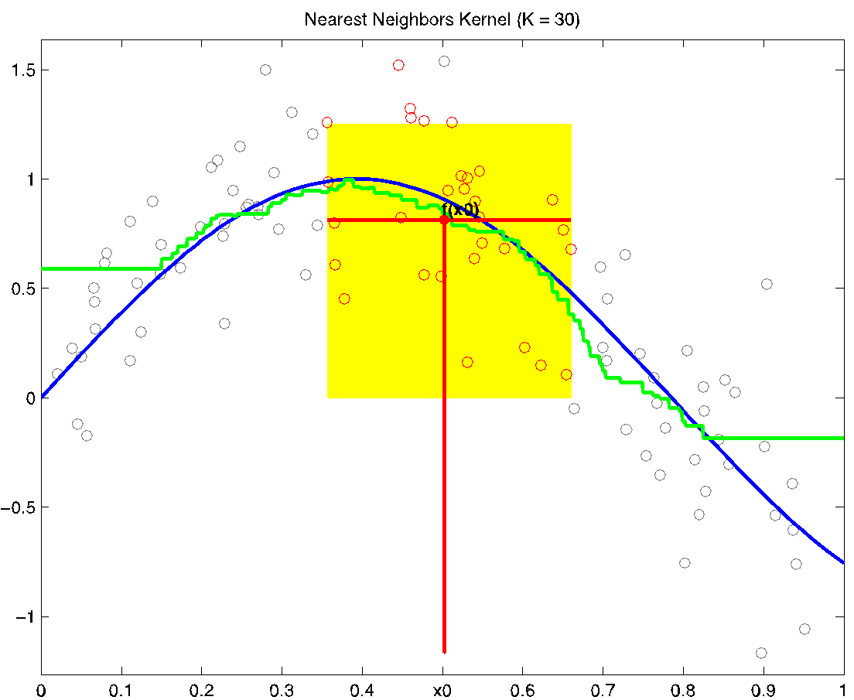
K Nearest Neighbor
Look at more than one neighbor, average result
Advantages:
More neighbors make the function better behaved
Weaknesses:
Still includes discontinuities (discrete decision to include/exclude)
Choose k carefully

Slide 18
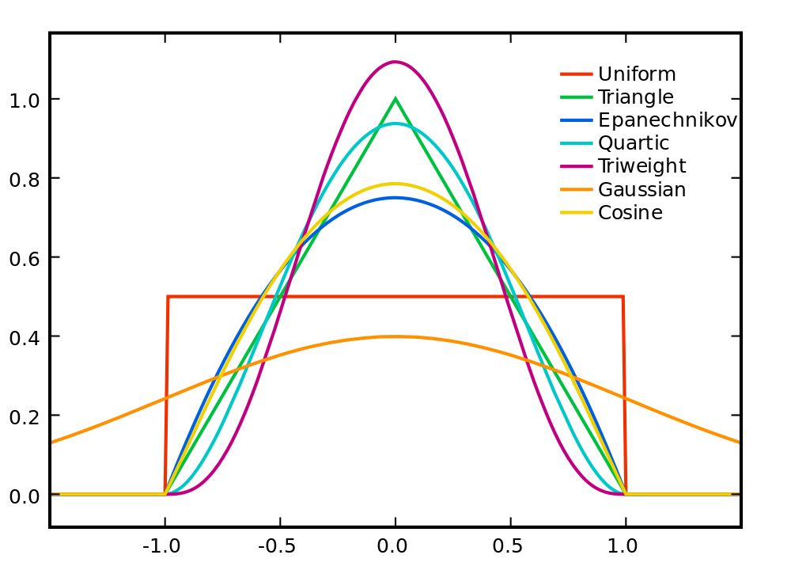

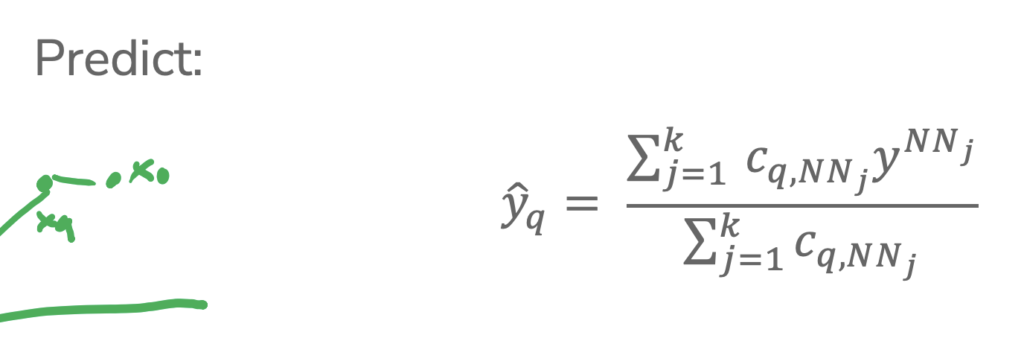
Weighted K Nearest Neighbor
Weigh the closer neighbors more (they are more similar)
“Kernel”: function transforming distance into weight
Popular kernels:
Uniform/boxcar
Gaussian
Epanechnikov
Different kernels generally give identical learned functions
Most kernels parameterized (how many points to look at), and emphasize low distance over far distance

Slide 19
Approximate Nearest Neighbor
Deals with runtime weakness by finding a “close enough” nearest neighbor rather than exact nearest neighbor
Locality Sensitive Hashing (LSH)
Yields a close neighbor with high probability
Want some probability of success

Slide 20
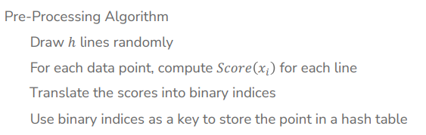
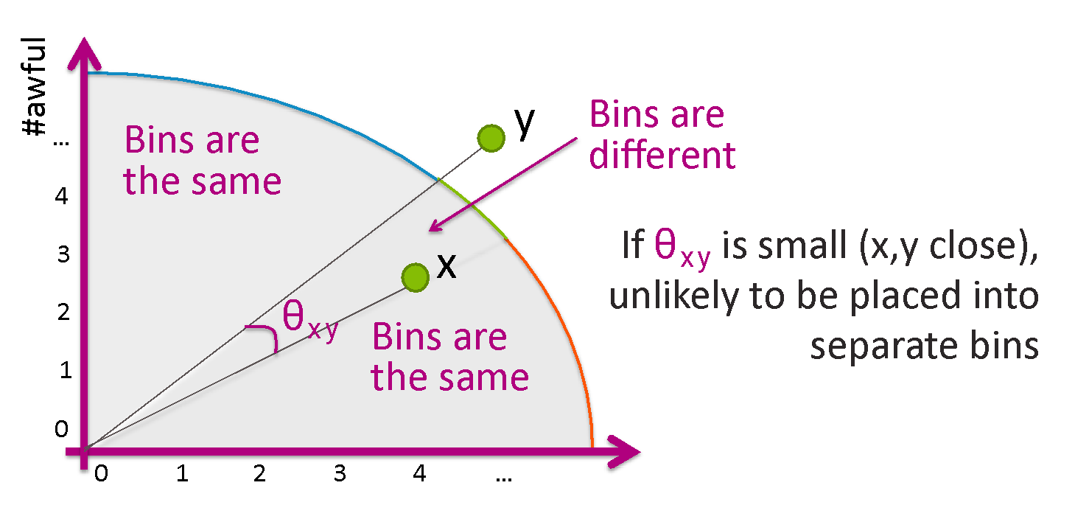
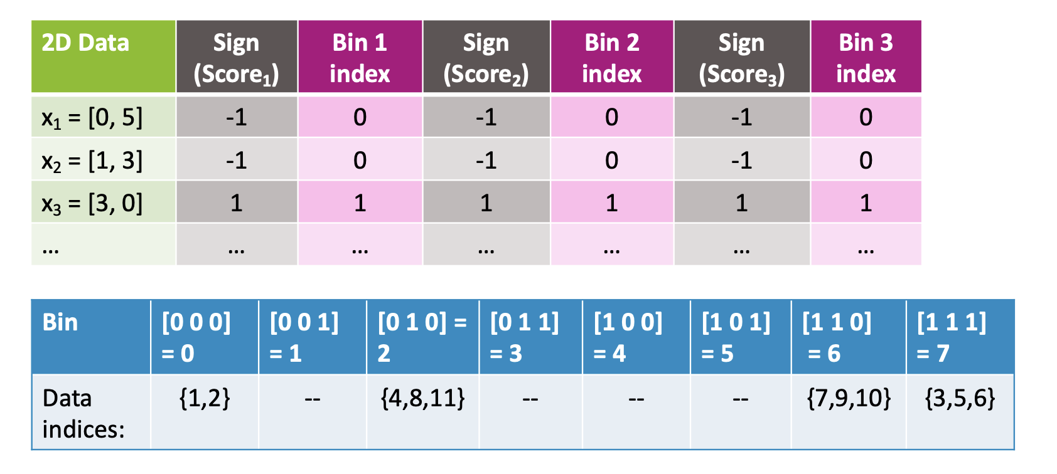
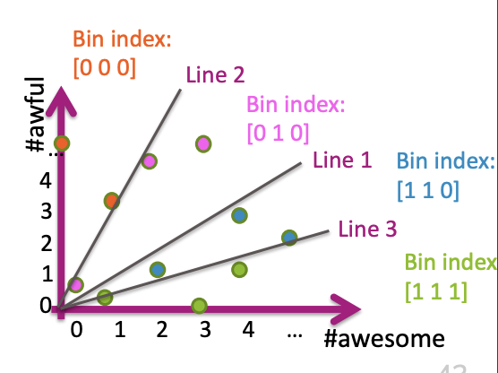
Locality Sensitive Hashing
Idea:
Break data into smaller bins based on proximity
Find exact nearest neighbor within a bin

Slide 21
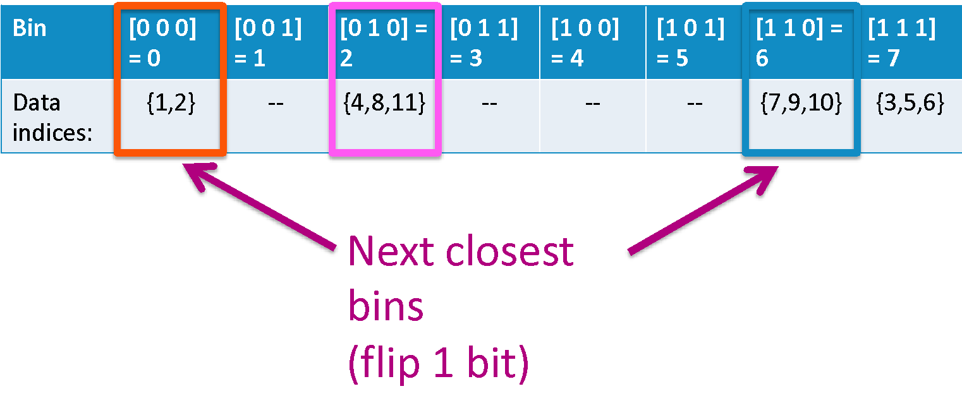
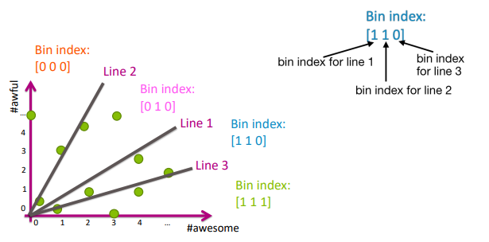
Binning
Use a line to separate the data and sort the groups on either side of line into bins
A random line works fairly well
Points with close cosine distance tend to be in same bins
Close bin indices differ by one bit

Slide 22
Kaggle Demo
What to do & how

Slide 23
Setup
Register a Kaggle account using your UW Google email (or a personal email)
Edit your profile and change your name to whatever you prefer
Does not have to be your real name!
Alternatively you can change your competition-specific team name on the competition page under the “team” tab
You will let us know which user you are as when submitting to Gradescope
Make sure to keep names appropriate!
Visit the Kaggle page linked on the course website and join the competition
Make sure to read through the competition description and evaluation pages!

Slide 24
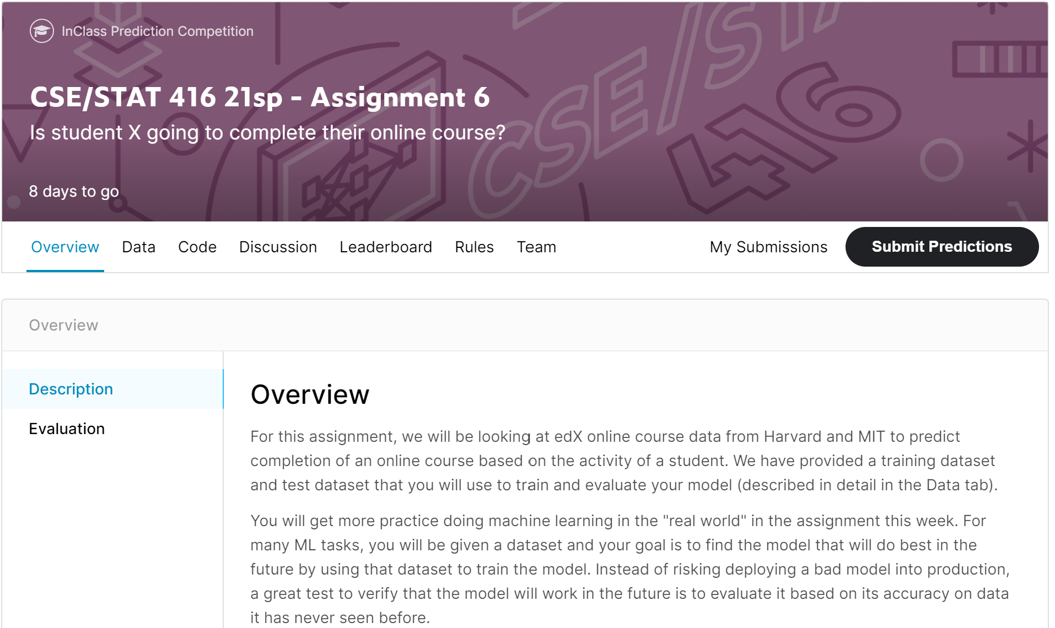

Slide 25
Data
The “data” tab allows you to download the raw data
You will have access to the training set and a test set
You should also read the data explainer to learn more about the data you’ll be working with
You can also view a portion of the data to get a better idea of what it looks like and how it’s structured!

Slide 26
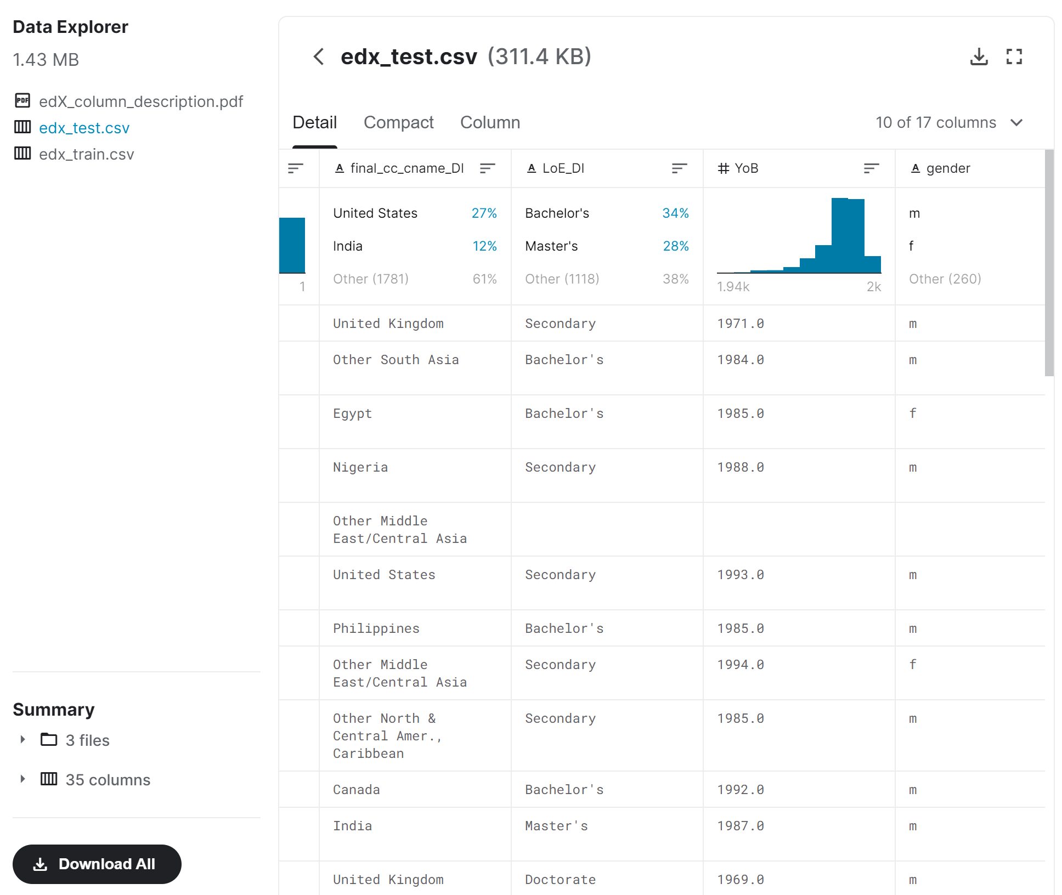

Slide 27
Leaderboards
Public
Is always available
Shows preliminary team accuracies on 1/3 of the full test data
Take the standings here with a grain of salt
Unless you are doing much worse than expected! You might want to re-evaluate your data processing and model if this is the case
Private
Is revealed when the competition ends
Shows the true standings of teams and their score on the rest of the test data set
This is the one you’ll be partially graded on!

Slide 28
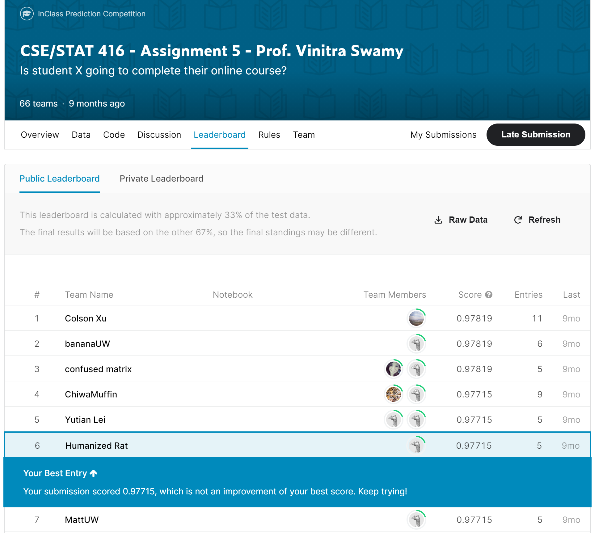
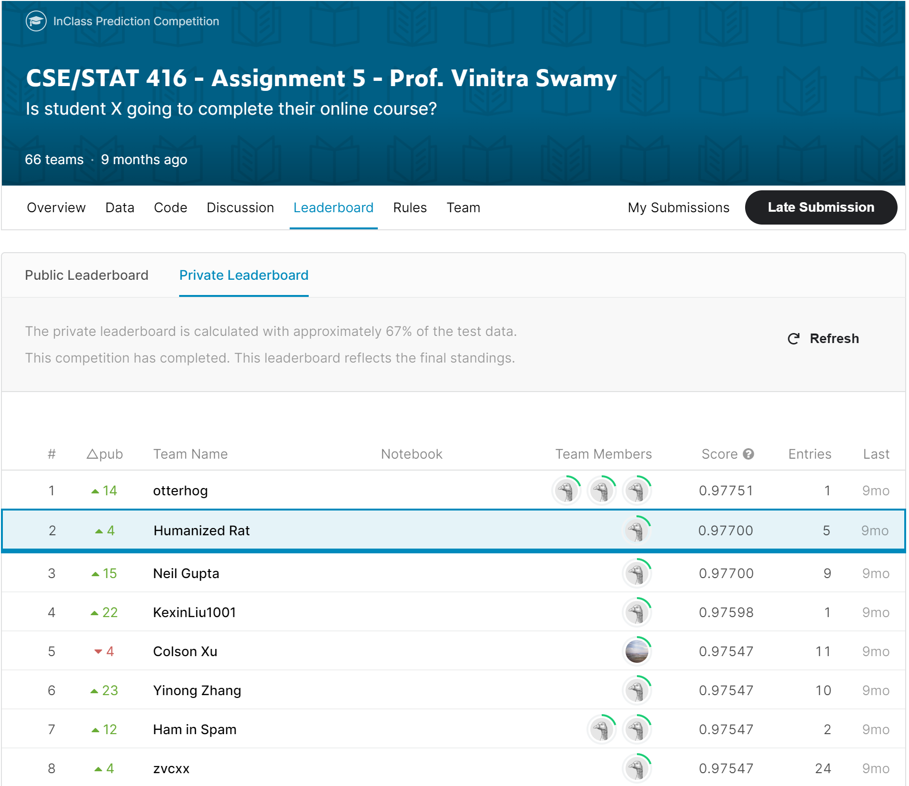

Slide 29
Submitting
Kaggle
Model predictions (CSV)
That’s it!
Gradescope
Notebook
Concept questions

Slide 30
Grading
The Kaggle portion is NOT graded on a curve
You will get full credit if you achieve 95% accuracy or greater on the private leaderboard
You can submit up to 5 times a day on Kaggle
Make sure to submit the rest of the assignment on Gradescope

